Slide 1
Workshop - Introduction to
QUALITY ASSESSMENT (QA) Guidelines
For NSL Operators
Notes:
Welcome to the Workshop on Quality Assessment (QA) Guidelines for NSL Operators
The version we will explore today is 2.1
These versions are likely to change as the Guidelines are periodically reviewed and updated.
So always be sure you are always using the latest one
These guidelines along with the QA form are in our Knowledge Hub

Slide 2
AGENDA
Introduction to Quality Assessment: What is QA
2) What will we do?
3) What are NSL’s guidelines for QA?
Introduce guideline document
Essential vs Non-Essential
3) How will operators be scored Introduce QA form and how it works
4) What to expect if you are called in for Feedback session:
5) Q&A and RECAP

Slide 3
What is QA
QA: Quality Assurance is how we assurance when callers ring into the National Support Line, they receive a consistent service.
We listen to calls, monitoring calls and provide feedback to operators
During Quality assurance we will listen to calls and provide feedback to operators

Slide 4
What will we do?
We will listen to a call in the past week
Mark the call using our QA guidelines
Compete a QA form against the guidelines
Score the form, with a score in two categories, needs a meeting or doesn’t need a meeting
Depending on the outcome we will send feedback or arrange a face to face meeting

Slide 5
Quality Guidelines?
Quality Assessment Guidelines establish standardised procedures and criteria
Evaluate an operator’s performance and ensure they adhere to standards
Ensure all operators receive same treatment, no matter who is assessing them
Reflect the specific training that an operator receives on the NSL learning pathway
Enable NSL to give direct feedback to operators
Help identify any future training or coaching needs, either for the individual operator or the Line as a whole

Slide 6
Essential vs Non-Essential
Essential criteria requires to be met in order for a QA not to require a face to face feedback session
If any essential criteria isn’t met we will ask the operator to have a feedback session with us
Non-Essential is criteria where we can pass along feedback to facilitate improvement but it doesn’t need a meeting to discuss the issue automatically

Slide 7
Switch to guidelines

Slide 8
SHOW QA FORM
Notes:
QA FORM
Basically to meet the standard
YES on all Essential
SCORE YES on at least 80% of the questions
An operator won’t meet the standard if they
NO on any Essential
Or Score below 80%
If an operator meets the standard they’ll receive a completed form
If they don’t they’ll be invited into a Feedback session

Slide 9
No Meeting required

Slide 10
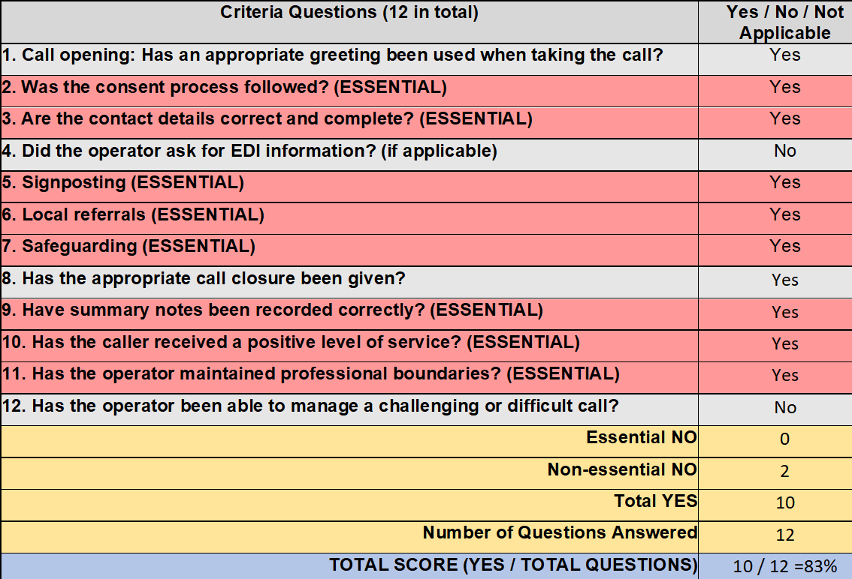
Notes:
Eg Case
Involved Safeguarding (for young child)
Involved Food referral
The operator took consent and details
Provided some signposting to Trussell Trust and Citizens Advice
Did a good job of writing up summary notes
The caller expressed gratitude and was thankful for the call
The operator met all the criteria for Professional Boundaries
BUT –
4)The operator did not take down EDI information
12) It also seems that at the beginning of the conversation, the operator was too quick to jump into a Food Referral without exploring around.
In other words, they initially failed to listen to and establish the caller’s needs, part of these Criteria.
And as it turned out, there was a young child involved and a safeguarding concern would eventually emerge about their welfare
So how did they score?
They answered all Essential questions
And they scored yes on at least 80% of the total questions they answered.
So this operator won’t be called in for feedback, but will receive the form and feedback in an email instead

Slide 11
Meeting required

Slide 12
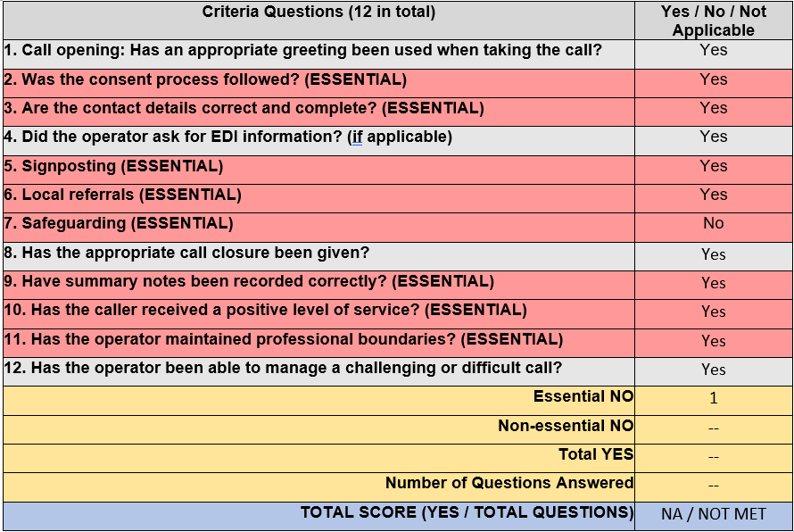
Notes:
EG.
Case involving a referral and signposting / Age Dispute
As it turns out it is a referral made to one of our Refugee Service centres, so the operator correctly took consent and details
They did everything else correctly in the case, but received a No in Safeguarding.
Why?
The operator did a great job on this call; however after hanging up the call, they made a direct referral to the local council Child Services for an Age Dispute case without first contacting SAT
While that effort is appreciated, it is ESSENTIAL that operators speak to Safeguarding before making those kinds of decisions. That’s clear in the training and on the Operator Manual
Result of this QA is the operator has not met the Required Standard.
They WON’T receive a completed form
Rather they will get a call inviting them to a Feedback session to review the call

Slide 13
What to expect if you are called in for a Feedback session:
First of all, relax!
This session is meant to improve your skills as a call handler
Provide constructive criticism as well as positive feedback
Notes:
There is no failing score.
So try to put your mind at ease and open to suggestions

Slide 14
What to expect if you are called in for Feedback session:
Play back and listen to the recording together
The operator will have the first opportunity to make comments on the call
Review the guidelines and completed QA form
Offer additional feedback and discuss future training or coaching needs
Notes:
We find that OPERATORS are often their own best critic and will immediately home in on their own weaknesses or needs.
It will be a good opportunity to refresh training skills

Slide 15
Q&A

